Slide 1
K-mer’s analysis for genome profile
ChunHsuan Lo (Jason)
Notes:
A key advantage of the k-mer based approach is that the k-mer profile can be computed
without a reference genome by directly scanning the sequencing reads, so that it works well for novel genomes.
Jellyfish (Marcais and Kingsford, 2011)

Slide 2
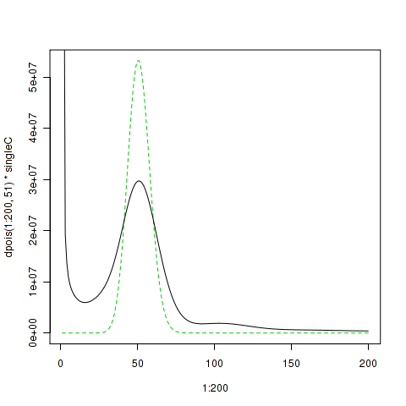
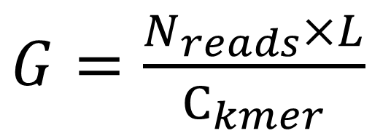
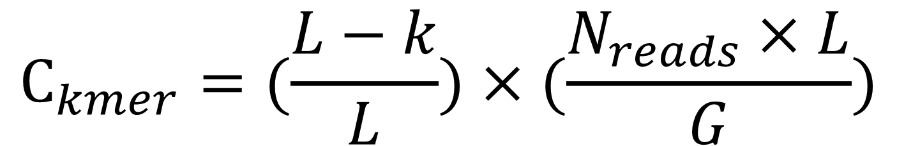
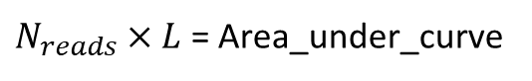
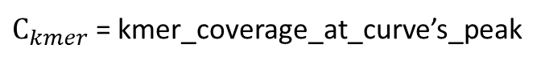
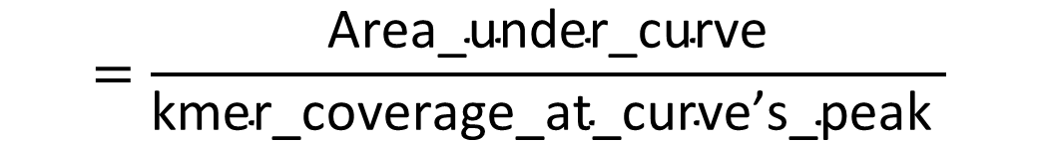
When L>>K…
$$C_{kmer}=(\frac{L−k}{L})×(\frac{N_{reads}×L}{G})$$
Therefore…
(total number of k-mers with a given frequency)
$N_{reads}×L$ = Area_under_curve
$G=\frac{N_{reads}×L}{C_{kmer}}$
$$=\frac{\text{Area}\text{_}\text{under}\text{_}\text{curve}}{\text{kmer}\text{_}\text{coverage}\text{_}\text{at}\text{_}\text{curve}\text{’}\text{s}\text{_}\text{peak} }$$
(the frequency or the number of times a given k-mer is observed)
$C_{kmer}$ = kmer_coverage_at_curve’s_peak
Notes:
The shape of the k-mer profile reflects the complexity of the genome sequenced. For example, if a homozygous repeat-free genome has been sequenced without errors or biases to a given average coverage level (e.g. 100x coverage), then the k-mer profile will be a Poisson distribution centered near that coverage (Kelley, et al., 2010; Lander and Waterman, 1988). More precisely, the center of the distribution will be centered at the average k-mer coverage available, which is defined as above.
An example of k-mer histogram. The x-axis, is the frequency or the number of times a given k-mer is observed in the sequencing data. The y-axis (V2), is the total number of k-mers with a given frequency.
P.S. Here Ckmer is the average k-mer coverage, Nreads is the number of reads, L is the average read length, k is the length of the k-mer, and G is the genome size. This effectively shifts the peak down by k/L percent from the mean nucleotide coverage.

Slide 3
Using traditional method

Slide 4
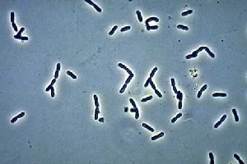
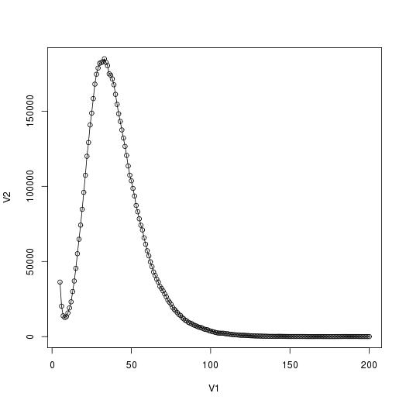

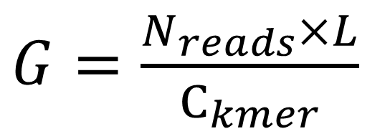
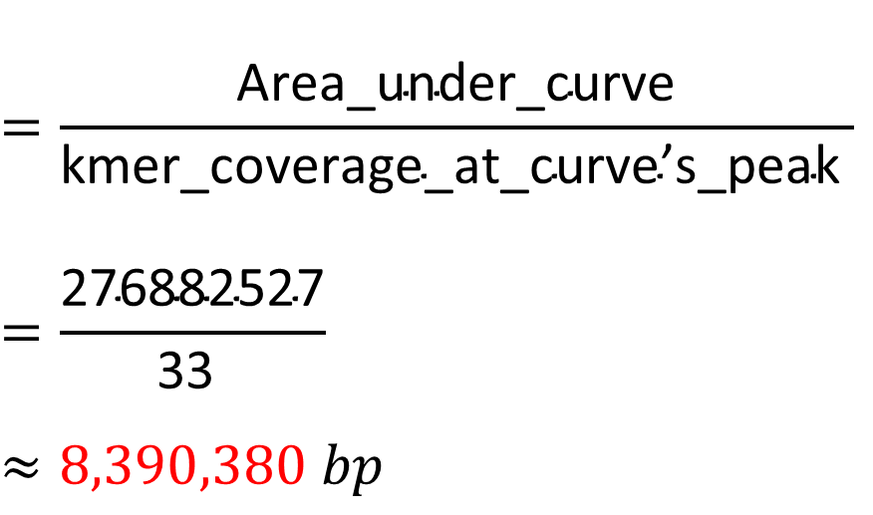
DRR021838 (Pseudomonas aeruginosa, 綠膿桿菌)
$G=\frac{N_{reads}×L}{C_{kmer}}$
(total number of k-mers with a given frequency)
Area_under_curve = 276882527
$$=\frac{\text{Area}\text{_}\text{under}\text{_}\text{curve}}{\text{kmer}\text{_}\text{coverage}\text{_}\text{at}\text{_}\text{curve}\text{’}\text{s}\text{_}\text{peak} }$$
$$=\frac{\text{276882527}}{\text{33} }$$
$$≈8,390,380 bp$$
(the frequency or the number of times a given k-mer is observed)
$$\text{kmer}\text{_}\text{coverage}\text{_}\text{at}\text{_}\text{curve}\text{’}\text{s}\text{_}\text{peak}=33$$
NCBI_genome: 6,601,410 bp

Slide 5
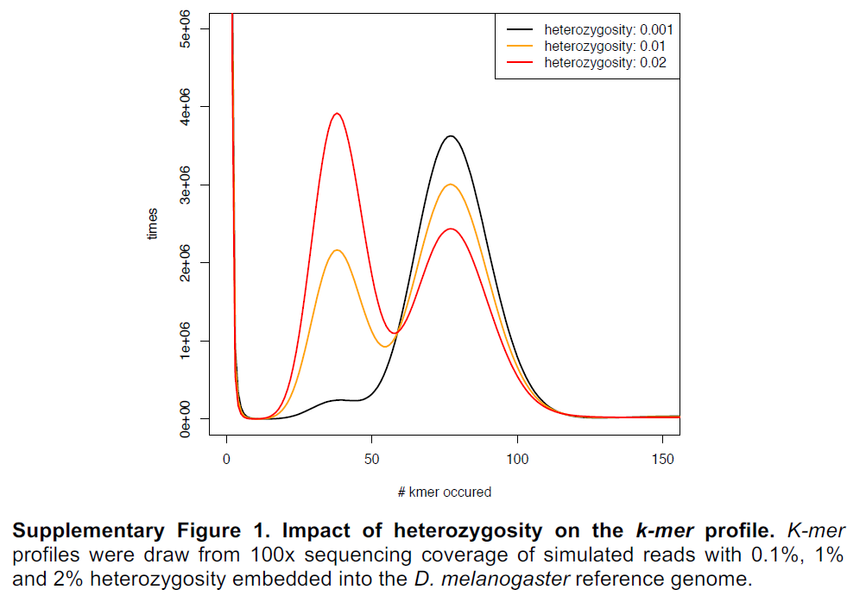
(total number of k-mers with a given frequency)
(the frequency or the number of times a given k-mer is observed)

Slide 6
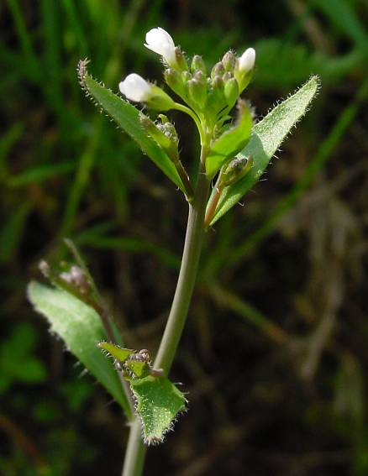
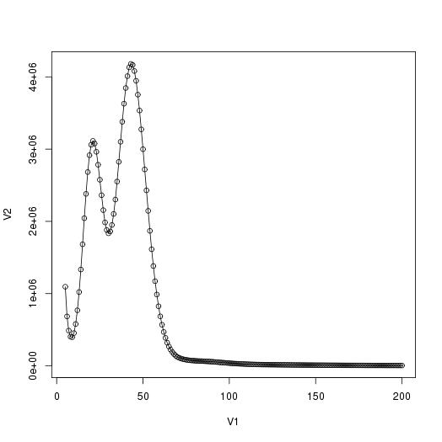
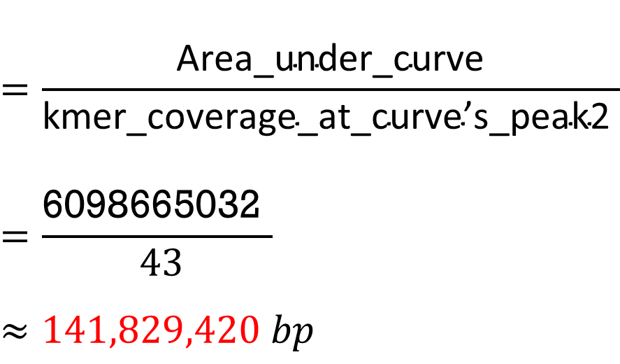
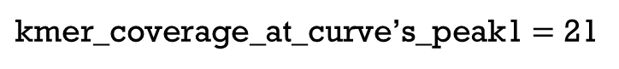
SRX1865253(Arabidopsis thaliana, 阿拉伯芥)
$G=\frac{N_{reads}×L}{C_{kmer}}$
Area_under_curve = 6098665032
$$=\frac{\text{Area}\text{_}\text{under}\text{_}\text{curve}}{\text{kmer}\text{_}\text{coverage}\text{_}\text{at}\text{_}\text{curve}\text{’}\text{s}\text{_}\text{peak}\text{2} }$$
$$=\frac{\text{6098665032} }{ 43}$$
$$≈141,829,420 bp$$
$\text{kmer}\text{_}\text{coverage}\text{_}\text{at}\text{_}\text{curve}\text{’}\text{s}\text{_}\text{peak}\text{1}=$ 21
NCBI_genome: 119,148,000 bp
$$\text{kmer}\text{_}\text{coverage}\text{_}\text{at}\text{_}\text{curve}\text{’}\text{s}\text{_}\text{peak}\text{2}=43$$
Notes:
N(genome size) = Total no. of k-mers/Coverage = Area under curve /mean coverage; However, here is a diploid type k-mer distribution, so there are two peaks at frequency=21 and frequency=43 respectively, where 21*2 almost equals 43 (The first (heterozygous) peak and the second (homozygous) peak reflect genomic k-mers present in either one or both chromosome sets, which are shared by all reads sampled from the respective loci. (Besides, here also avoids erroneous k-mers by excluding all k-mers occurring at frequencies smaller than certein value, which is at the valley between the first and second peak) and uses average frequency of those following two peaks as Coverage.) Therefore, the mean coverage is 42.5. And the area under curve is 6098665032. Finally, the genome size is 143,498,001bp, error rate = 6.6%. (134,634,692 bp, from Nature 14 Dec. 2000; Genome Haploid Length is 119,254,884 bp, from genomescope).

Slide 7
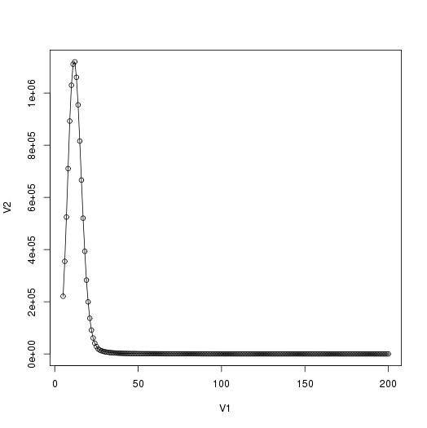
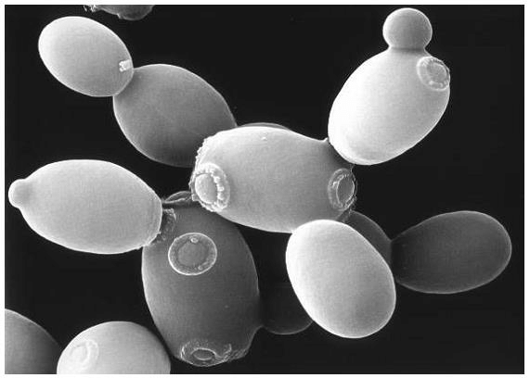
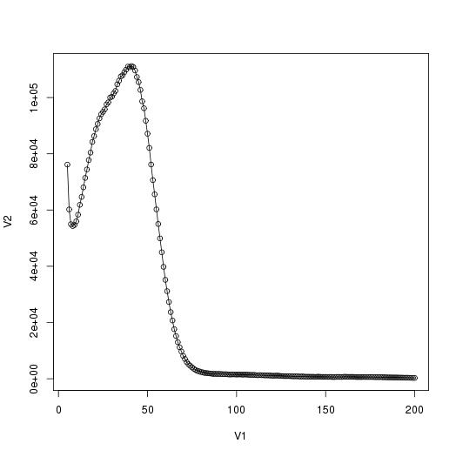
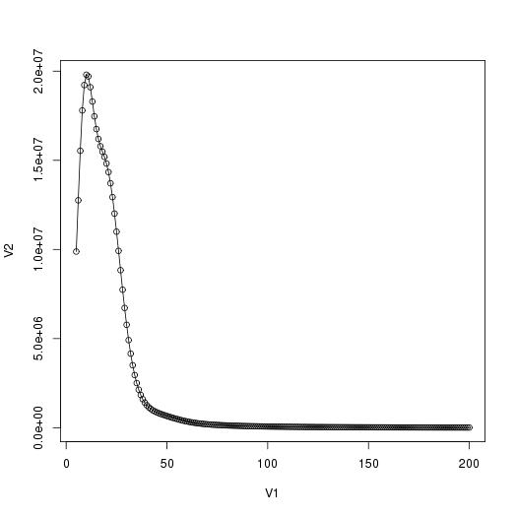
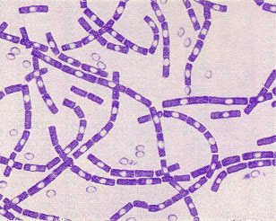
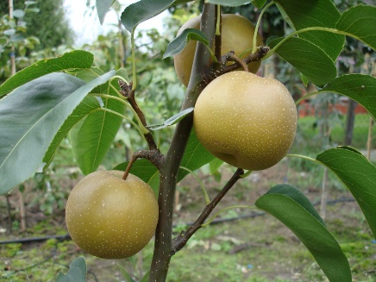
SRX1865253(Arabidopsis thaliana, 阿拉伯芥)
ERR038858 (Saccharomyces cerevisiae, 釀酒酵母)
DRR000183(Bacillus anthracis, 炭疽桿菌)
SRR609905 (Pyrus,bretschneideri, 鴨梨)
Notes:
N(genome size) = Total no. of k-mers/Coverage = Area under curve /mean coverage

Slide 8

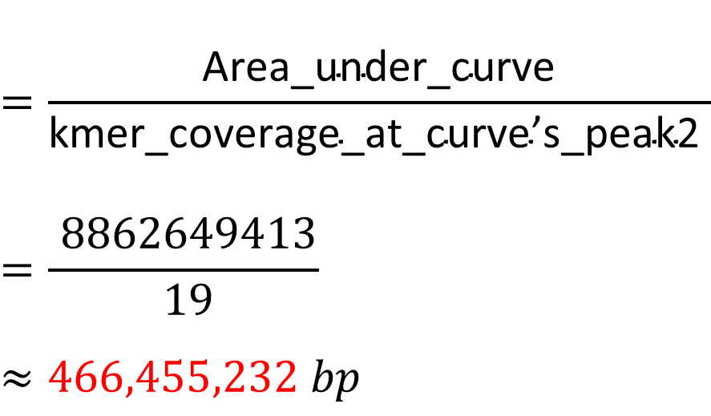
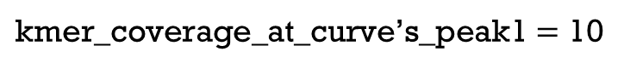
SRR609905 (Pyrus,bretschneideri, 鴨梨)
$G=\frac{N_{reads}×L}{C_{kmer}}$
Area_under_curve = 8862649413
$$=\frac{\text{Area}\text{_}\text{under}\text{_}\text{curve}}{\text{kmer}\text{_}\text{coverage}\text{_}\text{at}\text{_}\text{curve}\text{’}\text{s}\text{_}\text{peak}\text{2} }$$
$$=\frac{ 8862649413}{ 19}$$
$$≈466,455,232 bp$$
$\text{kmer}\text{_}\text{coverage}\text{_}\text{at}\text{_}\text{curve}\text{’}\text{s}\text{_}\text{peak}\text{1}=$ 10
NCBI_genome: 508,551,000 bp
$$\text{kmer}\text{_}\text{coverage}\text{_}\text{at}\text{_}\text{curve}\text{’}\text{s}\text{_}\text{peak}\text{2}=19$$
Notes:
This is very high heterozygous one, because the peak 1 is higher than peak 2, and these two peaks are very near and almost merged. and the second peaks is estimated at around 20. Therefore, N(genome size) = Total no. of k-mers/Coverage = 10458904344 / 20 = 522,945,217bp, Error rate = 2.1%. (512,000,000 bp, from Genome Res. 2013 Feb;23; Genome Haploid Length is 407,327,190 bp, from genomescope, http://qb.cshl.edu/genomescope/analysis.php?code=XJbpM1il3XyrYNAfOM4c).

Slide 9
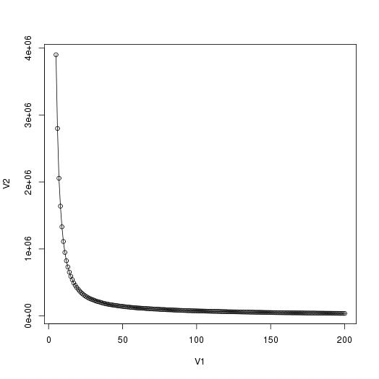
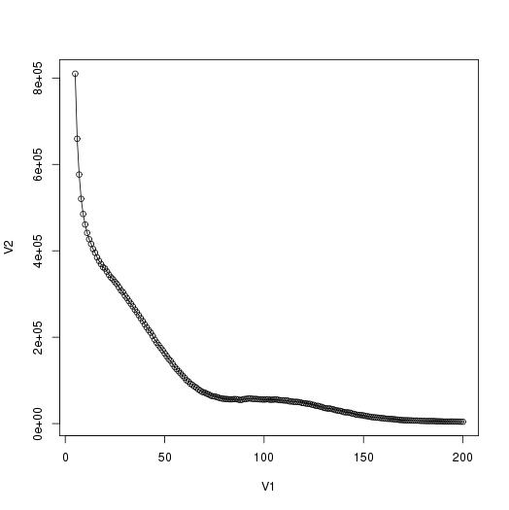
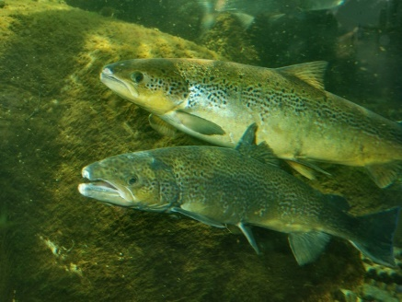
SRX1865253(Arabidopsis thaliana, 阿拉伯芥)
ERR038858(Saccharomyces cerevisiae, 釀酒酵母)
SRR2000035(Arabidopsis thaliana, 阿拉伯芥)
Unable to analysis
(Bacillus anthracis, 炭疽桿菌)
SRR609905(Pyrus,bretschneideri, 鴨梨)
ERR070478(Salmo salar, 大西洋鮭)
Unable to analysis
Notes:
N(genome size) = Total no. of k-mers/Coverage = Area under curve /mean coverage

Slide 10
Using GenomeScope Model’s method

Slide 11
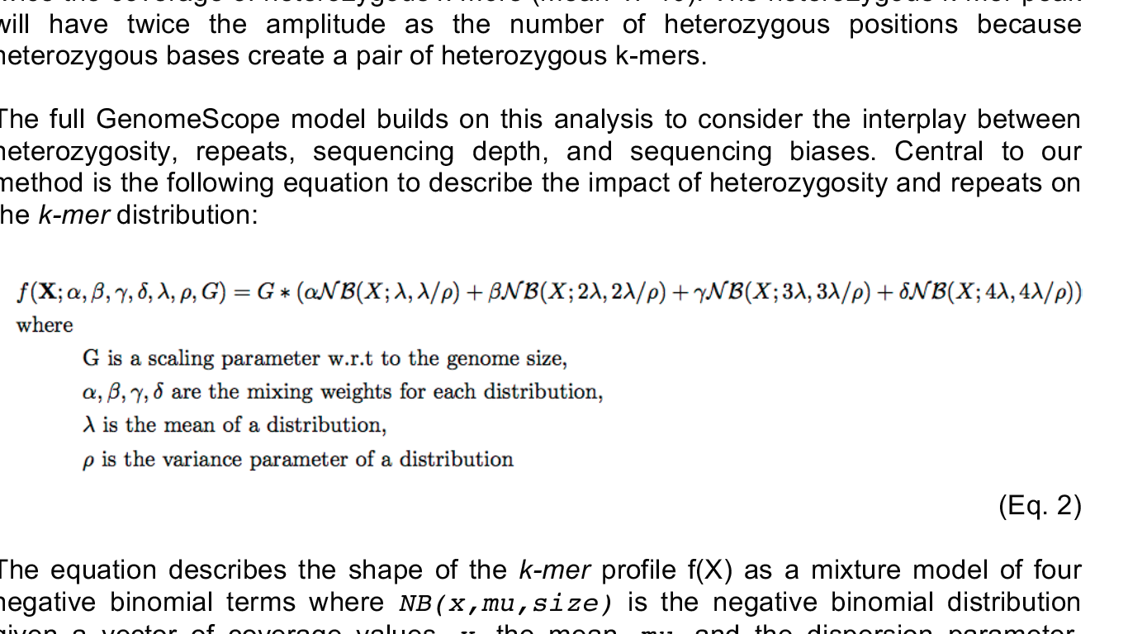
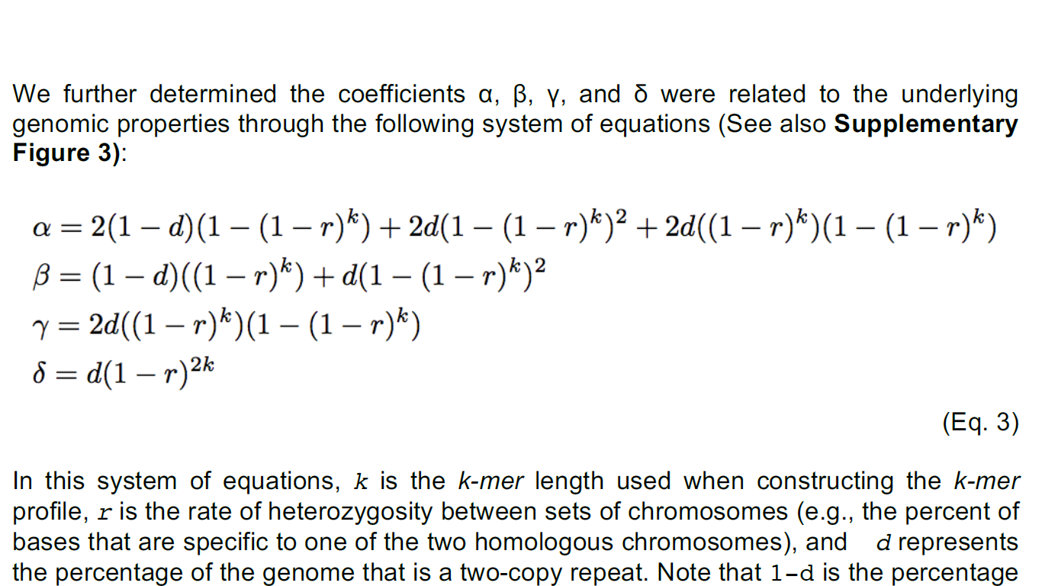

Slide 12
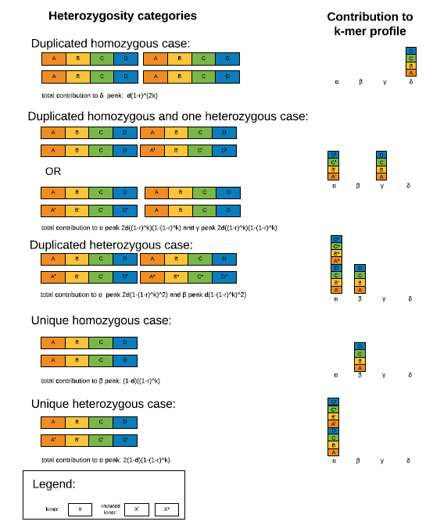

Slide 13
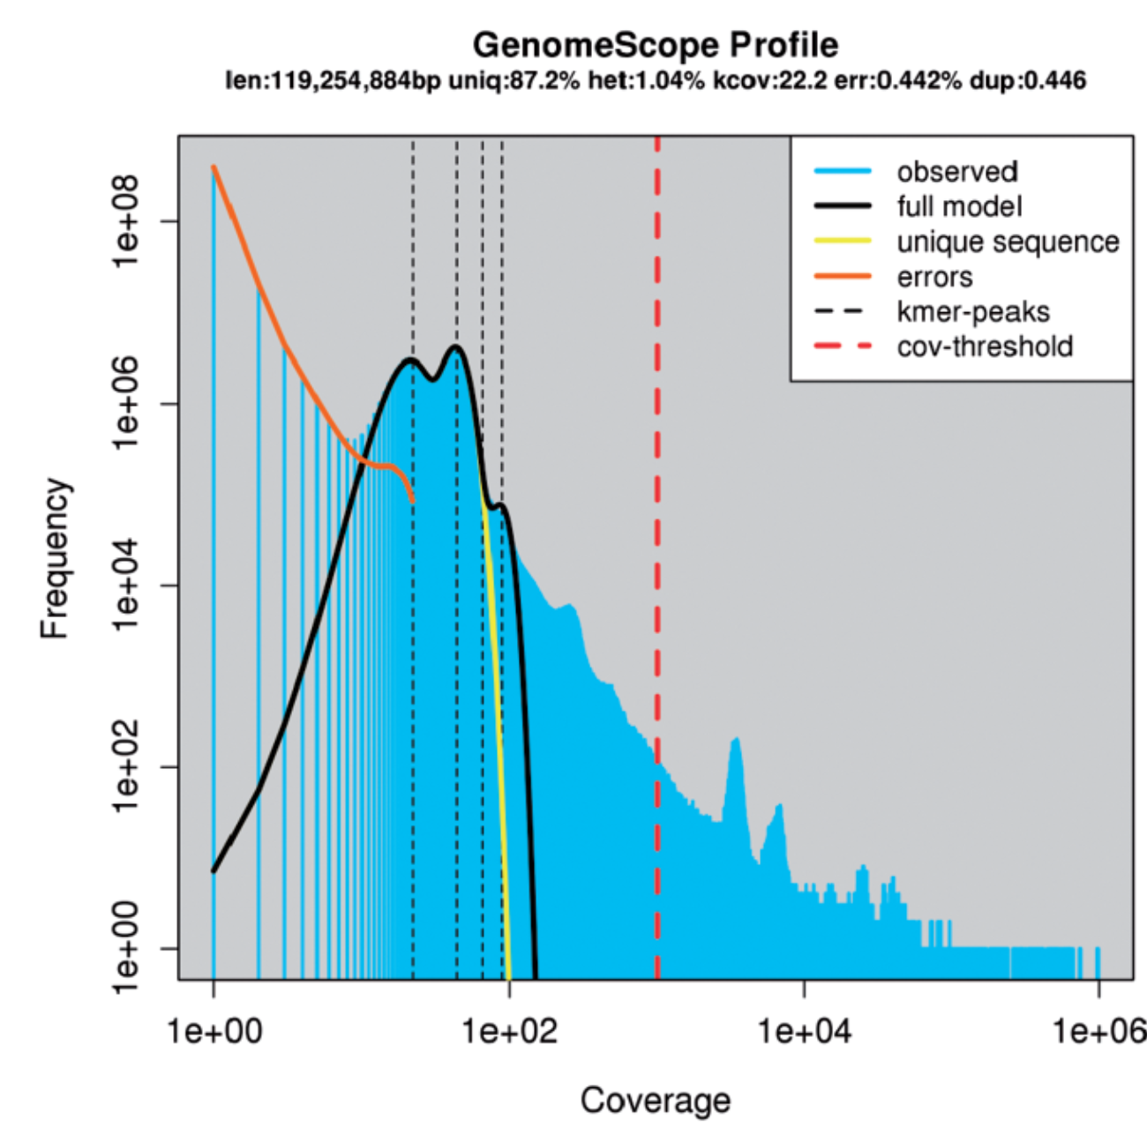
From: GenomeScope: fast reference-free genome profiling from short reads
Bioinformatics. 2017;33(14):2202-2204. doi:10.1093/bioinformatics/btx153
Bioinformatics | © The Author 2017. Published by Oxford University Press. All rights reserved. For Permissions, please e-mail: journals.permissions@oup.com

Slide 14
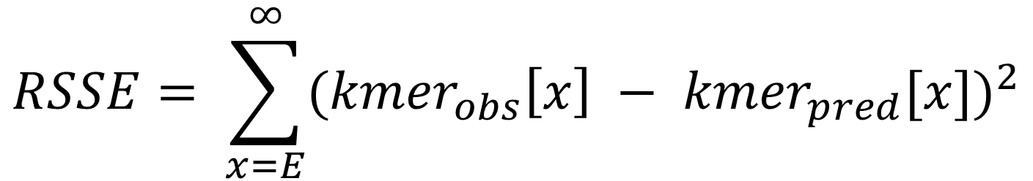
$$RSSE= \sum_{x=E}^{∞}{{({kmer}_{obs}\left[x\right] − {kmer}_{pred}[x])}^{2}}$$
Notes:
The final model parameters are decided by selecting the model parameters that have
the smallest residual sum of square error (RSSE) between the predicted values and the
observed values, excluding presumptive sequencing errors with low coverage below E,
that is determined by the position where the model results first intersects the observed kmer
frequencies. (Eq. 4). In the event of a near tie in RSSE, the algorithm selects the
model parameters that have higher rates of heterozygosity and smaller genome size
rather than lower heterozygosity and larger genome size. The RSSE is reported to the
user, as well as a more interpretable score representing the percentage of k-mers that
are not captured by the model.

Slide 15
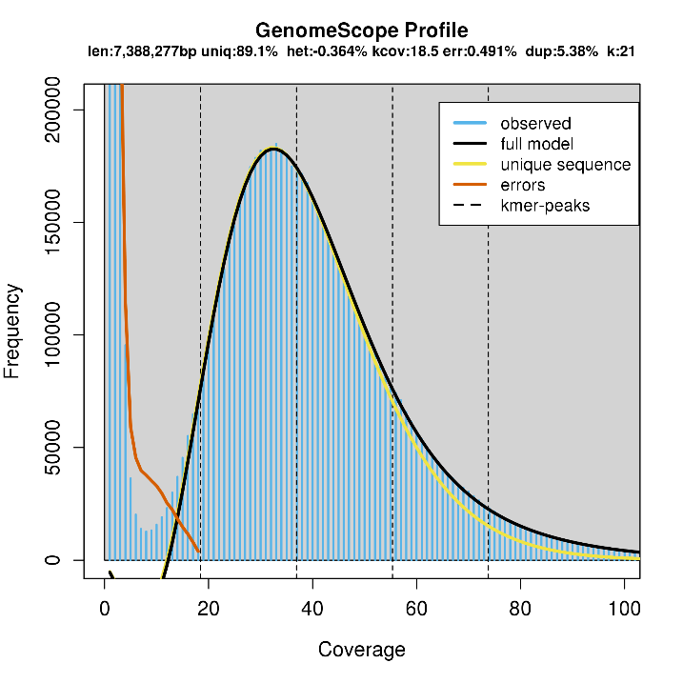
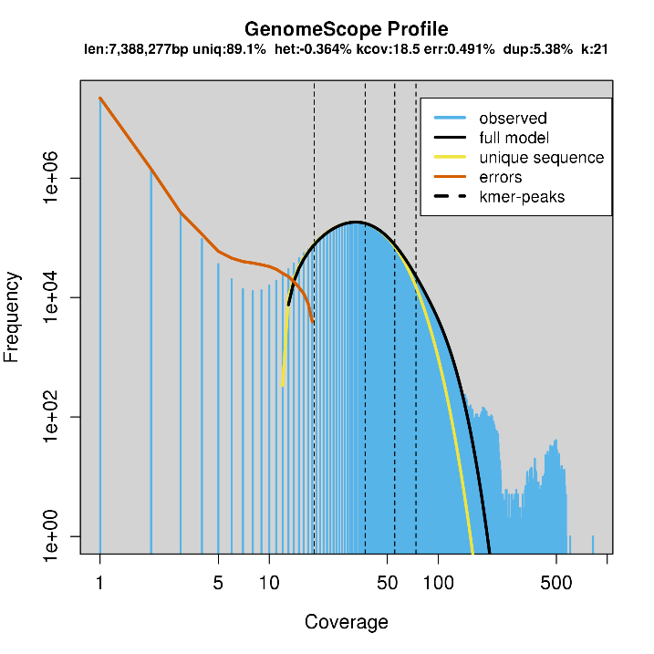
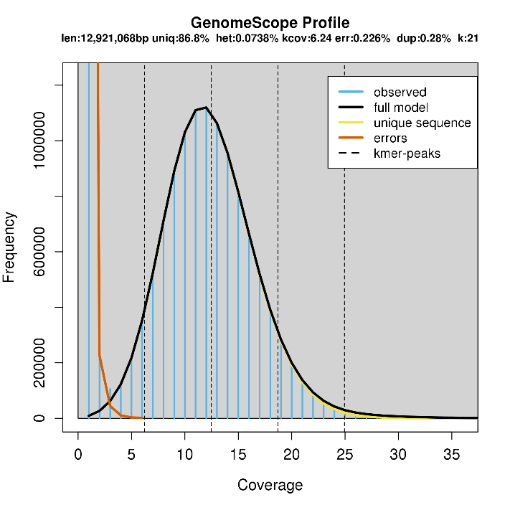
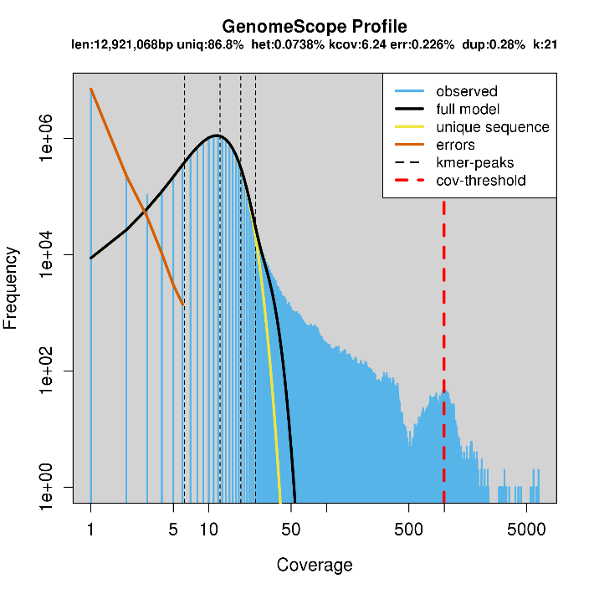
DRR021838 (Pseudomonas aeruginosa, 綠膿桿菌); Genome Haploid size: 7,388,277 bp
NCBI: 6,601,410 bp
ERR038858 (Saccharomyces cerevisiae, 釀酒酵母); Genome Haploid size: 12,921,068 bp
NCBI: 12,123,123 bp

Slide 16
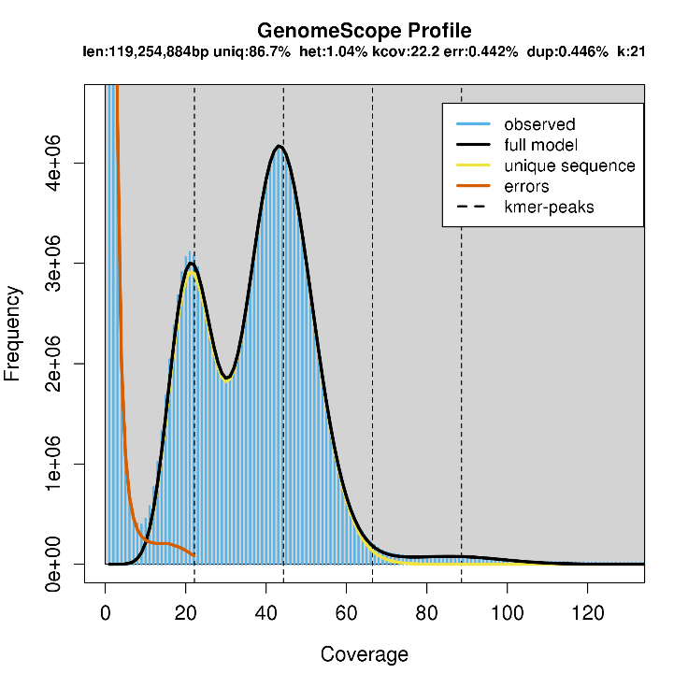
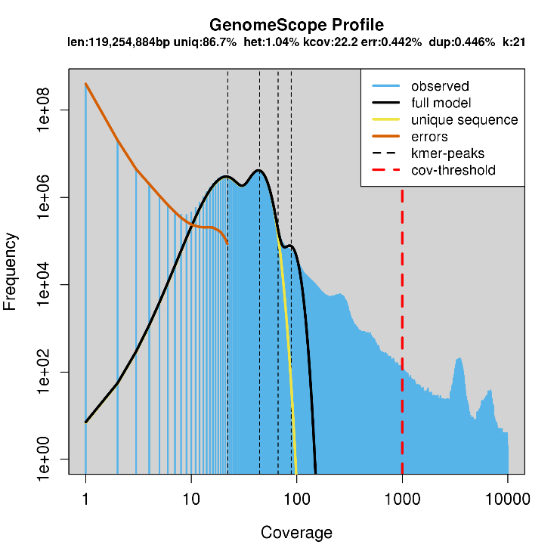
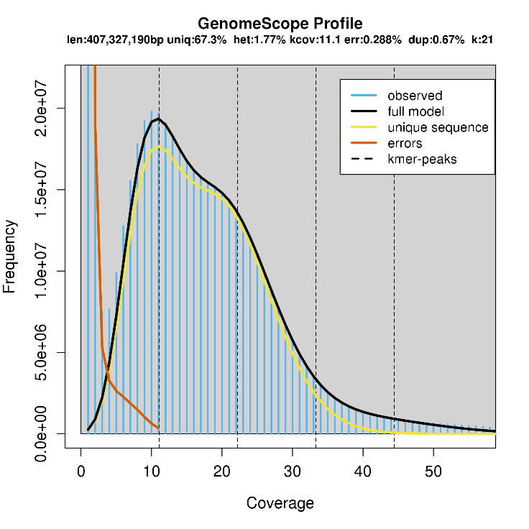
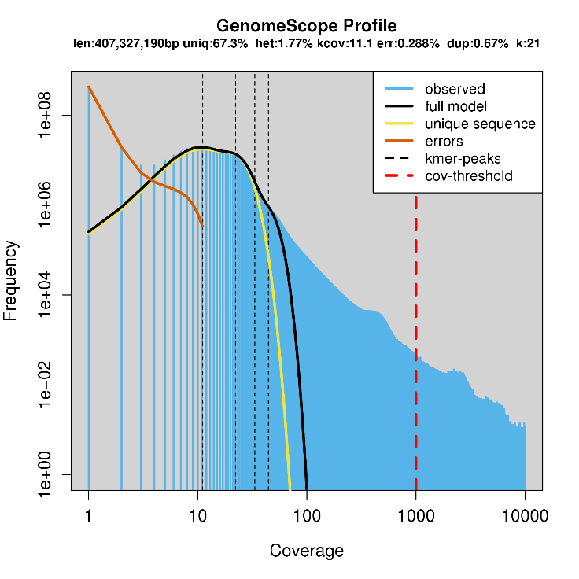
SRX1865253(Arabidopsis thaliana, 阿拉伯芥); Genome Haploid size: 119,254,884 bp
NCBI: 119,148,000 bp
SRR609905 (Pyrus,bretschneideri, 鴨梨); Genome Haploid size: 407,327,190 bp
NCBI: 508,551,000 bp

Slide 17
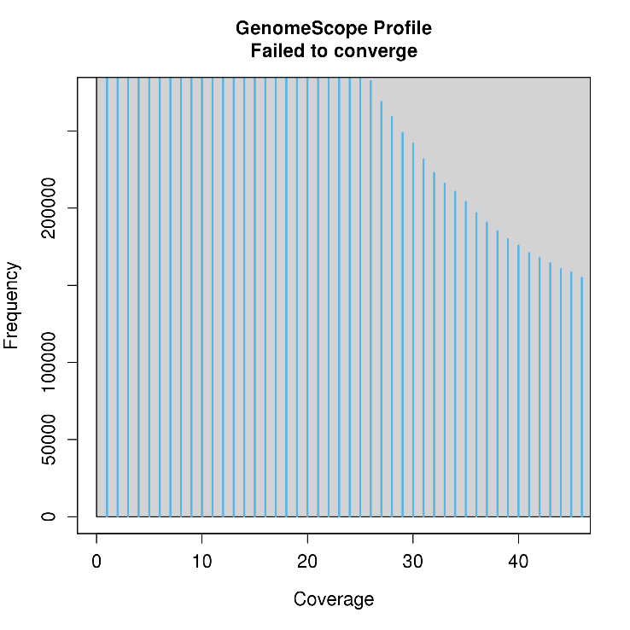
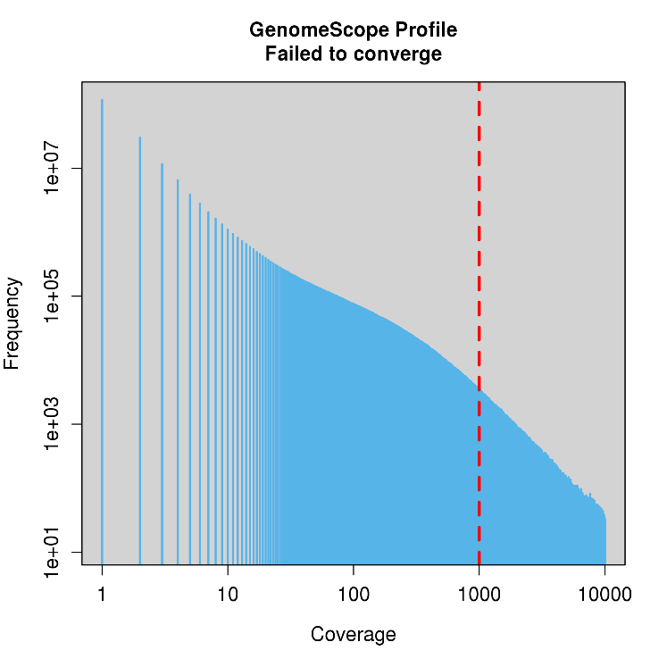
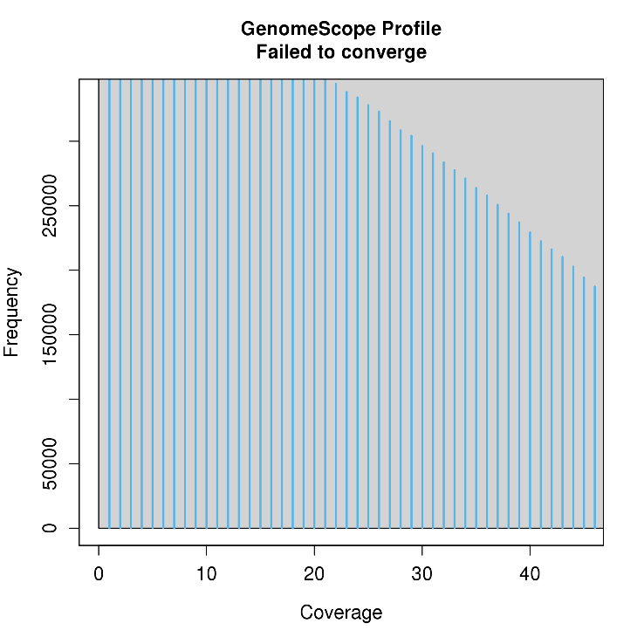
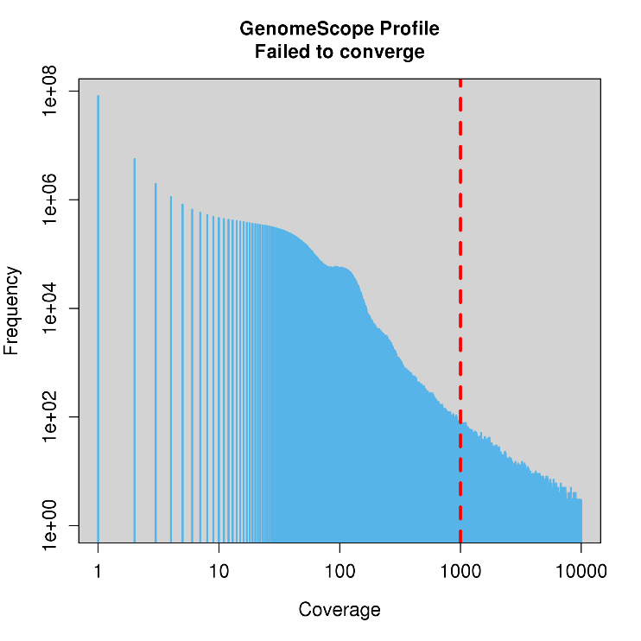
SRR2000035(Arabidopsis thaliana, 阿拉伯芥); Unable to fit the model
Unable to analysis
ERR070478(Salmo salar, 大西洋鮭); unable to fit the model
Unable to analysis

Slide 18
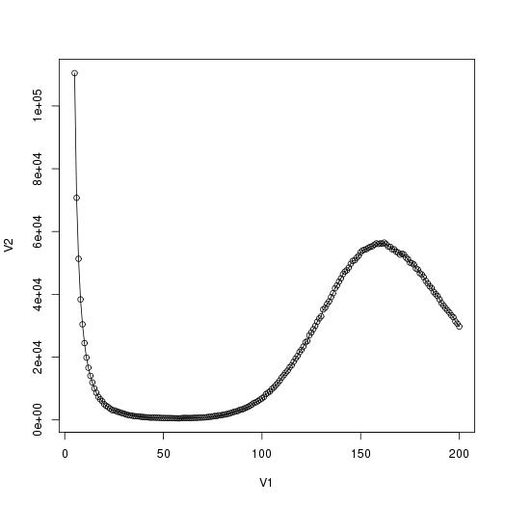
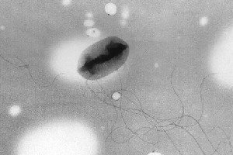
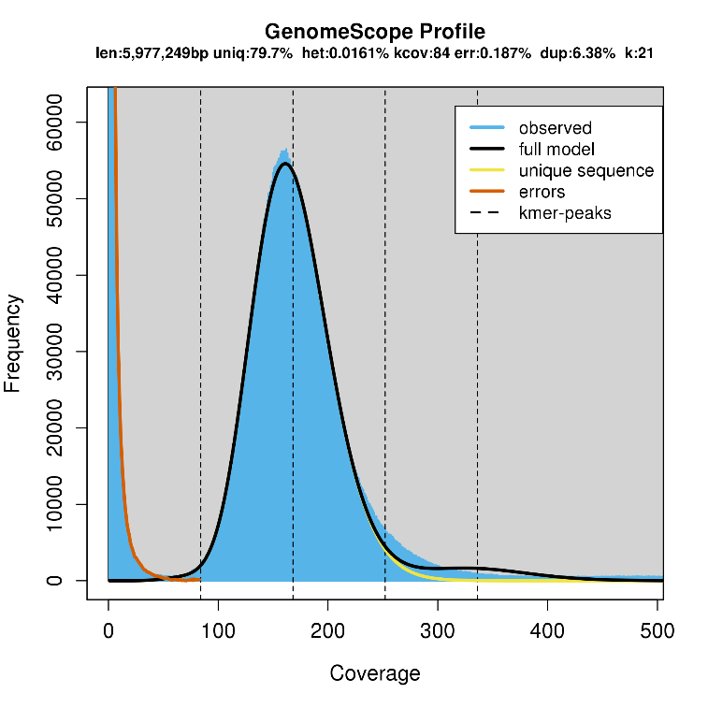
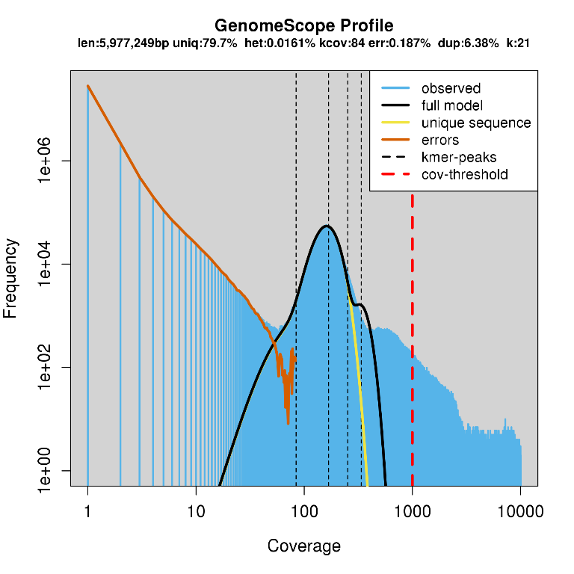
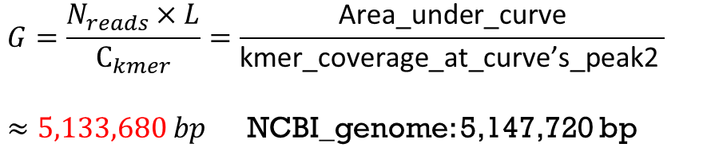
DRR015806 (Escherichia coli, 大腸桿菌)
Area_under_curve = 831656247
Genome Haploid size: 5,977,249 bp
$$\text{kmer}\text{_}\text{coverage}\text{_}\text{at}\text{_}\text{curve}\text{’}\text{s}\text{_}\text{peak}=162$$
$$G=\frac{N_{reads}×L}{C_{kmer}}=\frac{\text{Area}\text{_}\text{under}\text{_}\text{curve}}{\text{kmer}\text{_}\text{coverage}\text{_}\text{at}\text{_}\text{curve}\text{’}\text{s}\text{_}\text{peak}\text{2} }$$
$≈5,133,680 bp$ NCBI_genome: 5,147,720 bp

Slide 19
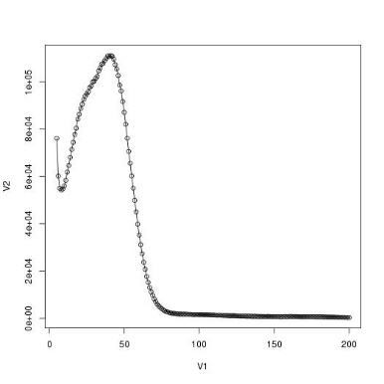
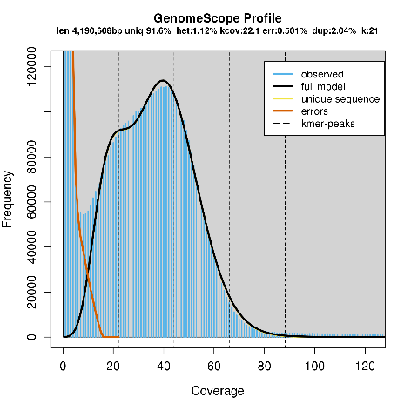















Success to fit the model (able to be analyzed)

Slide 20


















Fail to fit the model (unable to be analyzed)

Slide 21
The reason of fail

Slide 22
Thanks for the attention!

